Slide 1


End of Project Evaluation for Isoko y’Ubuzima: Final Report
Prepared and presented by Athena Infonomics and Greenwise Consult Ltd
21st July 2026

Slide 2
Contents
1
Introduction to the Project
2
Evaluation Objectives
3
Evaluation Methodology
4
Key Findings
SO1
Improving Decentralized WASH Governance
SO2
Improving Rural Drinking Water Services
SO3
Improving Rural Sanitation &Handwashing Services & Products
SO4
MVD WASH Response
5
Sustainability: What Will Last
6
Risks: What Remains Exposed
7
Recommendations for Government and Sector Partners

Slide 3
Introduction: Why the project was needed
  WASH Situation in the 10 Project Districts of Rwanda at Project Inception (2021)
Project Snapshot
Only 35% had basic water access
The 2021 baseline found the 10 core project districts averaged just 35.18% of households using basic or safely managed water services.
Name
Isoko y’Ubuzima
Funder
United States Government (USAID, later U.S. Department of State)
Nearly half of piped systems failed
The 2021 baseline reported that around 45% of rural piped water systems were non-functional, with a national NRW rate of 68.9%.
Cooperative Agreement Number
720-696-21-CA-00002
Weak district WASH capacity
The 2022 District Capacity Assessments across 10 districts showed an average score of 3.1/5 over 27 areas.
Duration
14 July 2021 – 13 July 2026 (five years)
Budget
Approximately USD 22 million
Sanitation products largely unavailable
Per the 2022 SBC-MBS Strategy, 76% of consumers in six districts reported DSCs unavailable and 74% reported SATO pans unavailable, compounded by a shortage of skilled installers.
Lead Implementer
Water For People
Awareness without behavior change
The SBC-MBS Strategy found CBEHPP raised awareness but failed to sustain behavior change: CHCs were largely non-functional, and only 21.7% of households had both soap and water at a handwashing station at baseline.
Consortium
● IRC WASH
● CARE International Rwanda
● Vitens Evides International (VEI)
● African Evangelistic Enterprise (AEE)
The project chose a systems-strengthening approach. Rather than only building new infrastructure, it invested in the institutions, financing mechanisms, service providers, and community structures that make water and sanitation services work reliably over time.

Slide 4
Introduction: What the project set out to do and where
Four strategic objectives of the project:
N
SO1
SO2
Improving Decentralised
WASH Governance
Building the capacity of national ministries and district institutions to plan, finance, and coordinate WASH services
Improving Rural
Drinking Water Services
Rehabilitating rural water systems, professionalising private operators, and reducing water losses
SO3
SO4
Improving Rural Sanitation &
Handwashing Services & Products
Creating demand for improved toilets and handwashing, and building a village-level sanitation market
Marburg Virus Disease (MVD)
WASH Response (added FY25)
Improving water, sanitation, and infection prevention in health facilities and public places
10 Core Intervention Districts
MVD Response added 5 districts
Project Coverage
Life-of-Project (LOP) Targets
10 Core Intervention Districts:
Rwamagana, Kayonza, Kirehe, Ngoma, Nyagatare, Ngororero, Nyabihu, Nyanza, Ruhango, Nyamagabe
MVD Response added 5 districts:
Gasabo, Gatsibo, Kamonyi, Kicukiro, Nyarugenge
120,000 people to gain access to basic water supply services
96,000 people to receive improved water service quality
100,000 people to gain access to improved sanitation and hygiene services

Slide 5

Evaluation Objectives
The final evaluation aimed to determine the overall success of the project in achieving its intended objectives, assess the outcomes and impacts generated, examine the effectiveness and sustainability of the implemented strategies, and identify key lessons and best practices to guide future programming.
Specific Objectives of the Final Evaluation
01
Evaluate the extent to which the project achieved its strategic objectives and intermediate results throughout the implementation period.
02
Document the main outcomes, effectiveness, and sustainability of the project’s accomplishments.
03
Assess performance against the indicators defined in the Performance Indicator Tracking Table (PITT) and develop lessons learned and recommendations to support future WASH programming.
04
Inform Government of Rwanda decision-making on how project-supported systems, tools, and practices can be institutionalised and continued after the project closes.

Slide 6
Evaluation Methodology
A structured, mixed-methods evaluation
The evaluation applied the OECD-DAC evaluation criteria across the four strategic objectives and the fifteen project districts. It combined quantitative and qualitative evidence and used contribution analysis to trace how the project's activities led to observed changes. Gender, equity, and social inclusion were integrated across all evaluation questions.
Approach — OECD-DAC Criteria
Relevance
Coherence
Effectiveness
Efficiency
Impact
Sustainability
Fit with GoR priorities and district WASH needs
Alignment with national systems and consortium partners
Delivery against SO1–SO4 targets
Cost, delivery mechanisms and adaptive management
Changes in service access, behaviour and outbreak preparedness
Whether gains survive project close in July 2026
Three-Phase Methodology (6 weeks total)
Phase 1 — Inception
(Weeks 1–2)
Phase 2 — Data Collection
(Weeks 3–4)
Phase 3 — Analysis & Reporting
(Weeks 5–6)
Review of project documents, national WASH policies, and sector literature
Finalisation of the evaluation framework mapping every question to specific indicators
Development of data collection tools in English and Kinyarwanda
Output: Inception Report
603 household surveys across the 10 core intervention districts
30 focus group discussions
44 in-depth interviews across all 15 districts – including 31 at district level, 7 from National Institutions, and 6 from implementing partners
Output: Cleaned dataset and interview transcripts
Quantitative analysis; qualitative analysis.
Systematic triangulation across all evidence streams
Stakeholder review of draft findings
Outputs: Final Evaluation Report, presentation, learning brief

Slide 7
Key Findings

Slide 8
SO1 Key Findings: Improving decentralized WASH governance
How the project strengthened Rwanda's WASH sector as a whole
The project's governance work did not stop at improving performance in ten districts. It also delivered sector-wide impacts that will continue to shape how WASH services are planned, financed, and regulated across all thirty districts of Rwanda.
Sector-wide impact blocks:
Institutional Strengthening | Capacity Building through WASH Systems Academy | Technical assistance to WASAC
DWASHBs are reported as more functional: meeting regularly, reviewing performance, and elevating WASH into district leadership discussions In the QIS, WASH Offices scored strongly on planning, budgeting, HR and systems thinking, and the KIIs corroborate a shift toward data-informed prioritisation Every one of the 20 institutions (10 offices, 10 DWASHBs) improved against the 2022 baseline, and by FY26 all scored at or above 75% in QIS assessment The building-blocks assessment shows the overall WASH system rising from 3.4 (2022) to 4 (2024), with the sharpest gains in planning, regulation and accountability, and the institutions block metrics | Over 500 professionals from national institutions, districts, and partner organisations have completed courses on various WASH, technical and finance themes Through FLCC training and detailed engineering designs, districts now hold WASH investment plans that are actively used for fund mobilisation The project led to the development of two Rwanda-specific courses on the IRC WASH Systems Academy — an online platform that continues to be available to Rwandan professionals after project close. | Training on Creditworthiness and Financial Sustainability opened a concrete pathway toward concessional and commercial finance for WASAC's investment pipeline The suite of standardized instruments provided to WASAC institutionalize consistent, climate-aware project preparation inside WASAC Development WASAC leadership's own request for a centralised repository to hold these products is a genuine ownership signal

Slide 9
SO1 Key Findings: Institutional Strengthening and Community Voice
Stronger district institutions and communities that hold governments accountable
The project assessed the performance of all twenty district WASH institutions across four rounds between 2022 and 2026 using the Qualitative Information System (QIS)#.
Community perception (figures from the endline survey)
96%*
HHs report district govt MORE involved in WASH than 5 yrs ago (2021)
72.5%*
HH awareness of WASH committees
Threshold | 2022 (institutions)# | 2026 (institutions)#
Scored above 75% | 5 (25% of total) | 20 (100% of total)
Scored above 80% | 0 (0% of total) | 17 (85% of total)
Scored above 90% | 0 (0% of total) | 10 (50% of total)
99.3%*
Community Scorecard participants report service improvements
71.1%*
Report district/village leaders raising WASH in community forums
District WASH Offices reached an average endline scores of 91%; District WASH Boards reached 83%#.
All ten districts produced WASH investment plans that were validated by the Ministry of Infrastructure#.
Highlights from capacity building
District WASH office / DWASHB are better equipped to perform the service authority functions like planning, budgeting, coordinating, monitoring
DWASHB water supply sub-committees conducted joint monitoring visits across both project and non-project systems
Rwamagana convening its own reflection meeting without project prompting
Resource mobilisation: New financing channels opened for WASH — far beyond the five-year target#
USD 8.15M#
New WASH funding mobilised across the sector — far beyond the five-year target.
388% of 5-year target
* Data from Final Evaluation Household Survey
# Data from Project Documents
Notes:
the capacity is lodged in permanent district structures rather than a project unit

Slide 10
SO2 Key Findings: Rural Water Access and Coverage
143,329#
225,916#
60.5%*
99.2%*
People gaining new basic water access
(119% of 120,000 target)
People receiving improved service quality
(235% of 96,000 target)
Household had access to basic or safely managed water from 35.2% (2022)
HHs now use improved water sources, up from 75% in 2021
Improved Water Access and Water Payment
System upgrades behind the gains
98.7%* of households pay for water
97.3%* of households have at least basic water service — an improved source within a 30-minute round trip
33# main water supply systems rehabilitated
39# leaking reservoirs repaired
28# sub-district metered areas created
Reliability of water service and improvements households report over five years
Biggest gains where water access coverage started lowest#
Nyamagabe
23.8% to ~52%
54.4%* of households reported continuous or often availability ("always — 30 days” or often — 21–29 days")
67.2%* of households reported experiencing some form of seasonal water shortage)
Nyabihu
38.8% to ~58%
Kayonza
44.7% to ~62%
99.8%* of households rated water quality as good or very good
89.9%* reported less waterborne-disease incidence than 2021^
Bars show each district’s rise from baseline (pale) to 2026 (green).
^ Households’ self-reported perceptions of water quality based on appearance, clarity, and smell, not microbiological or chemical safety.
* Data from Final Evaluation Household Survey
# Data from Project Documents

Slide 11
SO2 Key Findings: Capacity Building and Digital Strengthening
103 plumbers, 31 engineers trained#
Private Operators’ (PO) Capacity and Accountability#
104,008 customers mapped#
Trained in network maintenance and hydraulic modelling — both above target.
The project supported 12 POs to improve service delivery and 10 POs to improve accountability.
CMS-RWSS digital billing platform, integrated with MTN Mobile Money and commercial banks.
Faster Diagnostics — Leakage maps for 56 WSS developed via the mWater platform.
Network Optimization — 13 POs built EPANET hydraulic models for pressure and leak management.
Infrastructure Reliability — Hands-on maintenance of surface, submersible and dosing pumps reduced downtime.
Benchmarking — KPI-based tool drives peer-to-peer learning across POs.
Commercial Viability — 12 POs developed 5-year business plans; MKM (Rwamagana) reinvested in own pumps.
User Trust — Community Scorecards and interface meetings to 93% customer satisfaction at endline.
Improved Collection Efficiency — MTN Mobile Money and bank integration lifted efficiency to 86% (top POs: 95%).
NRW Reduction — Registering unbilled users into CMS-RWSS cut NRW from 65% to 15% in Rwamagana.
Professionalization — Paperless dashboards replaced manual billing; CMS-RWSS now a mandatory contractual requirement enforced by RURA and WASAC.
Both above training target
Meet the Targets
Digital billing live
* Data from Final Evaluation Household Survey
# Data from Project Documents

Slide 12
SO2 Key Findings: Non-Revenue Water and Households Experience
NRW Target versus NRW Achievement
How surveyed households experience the service
Non-Revenue Water trajectory (% of water)#
95.7%* consider their water provider more responsive than five years ago
63%
56.3%
39.3%
LOP target
38%
From knowing who is in charge to getting problems fixed
29%
95.2%* households know who manages their water system
87.2%* know where to report a water problem
52.7%* have reported a problem in the recent period
84.3%* of households reported problems are fully resolved by the operator
FY22
FY24 best
FY25 Q2
FY26 endline
"Non-revenue water" is the share of water produced that never reaches or is billed to customers. Reducing it means more water reaches households and more revenue is available to run the service reliably.
* Data from Final Evaluation Household Survey
# Data from Project Documents
Notes:
65% to 23%#
non-revenue water reduced by project end
One operator (MKM) scaled the fix across the whole district with no extra project funding — and self-financed pump replacement in two areas.

Slide 13
Key Findings: The Causal Link Between Governance and Water Services
How SO1 governance work created the conditions for SO2 water service improvements
The evaluation traced a clear causal chain from the project's governance investments under SO1 to the water service improvements delivered under SO2. Each step in the chain was tested against project monitoring data and stakeholder interviews.
Step 1 — Districts learned how to cost WASH services properly
Step 2 — Every district produced a credible investment plan
Step 3 — District plans attracted new financing
Step 4 — Financing was used to rehabilitate infrastructure and professionalise operators
Step 5 — Households experienced tangible service improvements
Thirty-five district staff and WASAC engineers were trained in Full Life Cycle Costing, which allowed districts for the first time to identify the true long-term cost of water and sanitation services in their area.
All ten districts prepared multi-year WASH investment plans with detailed engineering designs. These plans were validated by the Ministry of Infrastructure and are now the official basis for future WASH investment in these districts.
Because districts could now articulate what they needed and what it would cost, external financiers responded. Total new funding mobilised reached USD 8.15 million, well above the target of USD 2.1 million.
33 water supply systems were rehabilitated, thirty-nine leaking reservoirs were repaired, and twelve private operators received sustained business and technical training. WASAC branches were strengthened at the same time.
The share of households using improved water sources rose from 75% to 99%. Non-revenue water fell from 63% to 39.3%. 143,329 people gained new access to basic water services — 119% of the target.

Slide 14
SO3 Key Findings: Sanitation Market and Household Investment
119,262#
245,519#
78.5%*
15#
People gaining basic sanitation access
(119% of 100,000 target)
Number of people buying Products and services from the DSCs and or community sanitation showrooms
Affordable sanitation product options available across the market
(100% of target)
HHs using improved-type toilet at endline
The SO3 sanitation component was driven by a Market-Based Sanitation (MBS) approach, built across following three interdependent pillars:
Demand Activation
Supply Systems
Financing Mechanisms
150# sales agents trained
Outlets established
Products co-designed
3200+ Village Savings & Loan Associations (VSLAs) mobilized#
Built on the Government's CBEHPP: Market established on the Government's existing community health platform.
10# District Sanitation Centres
7# specific sanitation products co-designed with local communities
43% of upgrading households used savings-group loans*
Men and women decide together: Joint decision-making is now common pattern in household sanitation investment.
127# community sanitation showrooms
#Wooden toilet seats co-designed specifically for the elderly and people with disabilities
36.5% used their own savings*
Why households upgraded*
Health and hygiene benefits
94%
People trained
Bank of Kigali launched WASH-specific loan product
Cleanliness
73%
Privacy and dignity
70%
704# masons
336# cell-level masons
Safety for women and children
67%
Key
Output
127# MBS Demonstration Villages/ iMBS – showcased real solutions, made sanitation collective community responsibility (through ownership and monitoring processes)
* Data from Final Evaluation Household Survey
# Data from Project Documents
Notes:
This shift to professionalized demand activation was considered a "game changer," leading to a tenfold increase in sales in FY2024 alone. By project close, agents had conducted tens of thousands of household presentations, resulting in over 26,000 SATO units sold

Slide 15
SO3 Key Findings: Hygiene Behaviour Change and Schools
Household hygiene has changed — schools are the next frontier
Household hygiene
Schools — official figures versus what was observed on the ground
65%*
of households now have both soap and water at their handwashing station — up from 21.7% in 2022
162.5%*
of the 40% target
REPORTED — OFFICIAL WASH MIS
87%#
of schools have soap and water — 124% of the 70% target
EVALUATION — SPOT-CHECK ON THE DAY
41%*
had both soap and water present at the visit (41 schools, six districts)
vs
2022
21.7%
40% target
2026
65%
What the spot-check of 41 schools actually found*
Both soap and water present
41%
95%* correctly identify soap and water as the right handwashing combination
97%* wash hands more often than five years ago (80% much more, 17% somewhat more)
92%* recall “Handwashing with soap at critical times prevents disease”
Water but no soap
20%
No handwashing facility at all
29%
Root cause: inconsistent soap supply, not missing infrastructure
Handwashing stations have been built. The problem is that soap runs out and is not consistently restocked, so official coverage figures overstate what pupils find on any given day.
Most effective Outreach/Demand Creation channels*
Hygiene Focal Points
88%
Village Agents
81%
Community Health Workers
75%
* Data from Final Evaluation Household Survey
# Data from Project Documents

Slide 16
Key Findings: The Causal Link Between Governance and Sanitation Services
How SO1 governance work created the conditions for SO3 sanitation improvements
The evaluation traced the causal chain from SO1 governance investments to the sanitation outcomes delivered under SO3. Unlike the water chain, this pathway runs through market systems and institutional enabling rather than public financing — and it delivers strong supply-side results against a household outcome that fell short of target.
Step 1 — District and national actors built sanitation-specific capability
Step 2 — Sanitation was embedded in district plans and oversight
Step 3 — Market actors were organised and anchored in permanent institutions
Step 4 — Supply and demand were stimulated together
Step 5 — Household gain from improved accessibility and products
Market-Based Sanitation, costing and advocacy courses were delivered to district staff, WASAC, MININFRA, MINALOC and PSF. District WASH office QIS scores rose across all ten districts, with sanitation data captured through the Ministry of Health hygiene platform.
District investment plans covered sanitation alongside water, drawing on the National FSM Master Plan. DWASHB sanitation and hygiene sub-committees, district reflection meetings and Imihigo brought sanitation into routine district performance review.
A District Sanitation Centre in every district, 15 sales agents per district, 127 community showrooms and 300 masons and suppliers were linked into referral networks — anchored in the Private Sector Federation, not the project, with ASSERWA capacity rising from 50% to 75%.
SBC agents and Village Agents mobilised 7,744 community groups, generating 35,241 sanitation and hygiene product sales including 26,000 SATO pans (FY24). DQ Master Trainers were established locally, enabling DSCs to recruit and coach sales agents without external assistance.
Households using basic or safely managed sanitation reached 71% against a 79% target — 90% of target. Households were investing more in sanitation upgrades, especially those visited by demand creation agents. Sanitation was recognized as a major need, even if affordability was a challenge for many.
Notes:
Framing note: this chain is deliberately not presented as a clean success cascade. Steps 1-4 are well evidenced; step 5 is where the chain attenuates. The sanitation endline (71%) sits below the 79% LOP target and below the FY23 figure, so the honest verdict is that SO1 governance work reliably produced market-system capacity, but market capacity alone does not close the household sanitation gap. Two constraints explain the gap and should be stated if asked: household affordability under product price inflation, and the unfinished faecal sludge management service chain (Bugesera FSTP still at design stage; sanitation coordination assessed as weak; no sewerage tariff). Contribution framing: parallel GoR investment through CBEHPP and district Imihigo also drove sanitation outcomes.

Slide 17
SO4 Key Findings: Marburg Virus Disease WASH Response
When Rwanda declared its first Marburg Virus Disease outbreak in September 2024 (62 cases, 15 deaths), USAID modified the project with an additional USD 1 million to respond. Despite regulatory approvals that delayed construction start until the beginning of the final project year, all major infrastructure targets were met or exceeded.
Infrastructure achievements against target#
Training and behaviour change achievements
TARGET (100%)
ACHIEVED
1,735 frontline healthcare workers trained in IPC#
289 through a national Training-of-Trainers programme · 1,446 cascaded across 46 hospitals
69% to 85% average IPC knowledge score, before and after training#
Health facilities with new permanent water supply
Target 9 · Delivered 9 — Fully achieved
100%
Health facilities with internal water connections
Target 33 · Delivered 33 — Fully achieved
100%
Handwashing facilities inside healthcare settings
Target 25 · Delivered 25 — Fully achieved
68 WASH FIT# trainers certified to lead ongoing facility improvements nationally
National guidance finalized#
National IPC Guidelines
IPC Facilitator Training Manual
15 Standard Operating Procedures
with the Ministry of Health
90,000 community members reached by mobile-van outreach across nine districts#
100% of the outreach target
100%
Handwashing facilities in public places
Target 26 · Delivered 26 — Fully achieved
100%
Improved sanitation in health facilities
Target 4 · Delivered 7 — Exceeded (175%)
175%
Completed / achieved
Ongoing — in active pipeline
Target (100%)
IPC = Infection Prevention and Control. National guidance was finalised by the Ministry of Health with project support.
* Data from Final Evaluation Household Survey
# Data from Project Documents

Slide 18
SO4 Key Findings: Integrated Approach to Health and WASH in Rwanda
Beyond the physical infrastructure delivered, the most significant outcome of the Marburg response is a new way of working — one where health and WASH institutions plan, invest, and respond together. This integration is a lasting contribution of the project to Rwanda's outbreak preparedness.
Facility-level outcomes: Infection control and WASH gains at two referral hospitals#
The integration outcome
Four ways of working the Marburg response established at scale in Rwanda’s rural health system
Kibagabaga Level II Teaching Hospital
Infection rates fell sharply over 2025
Neonatology
10%
1
Joint MoH–MININFRA–WASAC coordination
Shared coordination on facility WASH investment, planning, and monitoring
Maternity
1.5%
2.5%
1%
Start of 2025 to End of 2025
11 new handwashing facilities installed across the hospital
Green-red isolation zoning installed to separate clean and contaminated areas
2
WASH FIT adopted as routine practice
The WHO health-facility improvement tool is now routine facility management
King Faisal Hospital
183 clinical and support staff trained on site
3
Shared channels for outreach and IPC training
Community outreach and infection prevention and control training were delivered through the same channels
Dedicated IPC and WASH unit established to lead infection prevention and control
Environmental swabbing detected pathogens (Klebsiella), triggering deep-cleaning protocols
4
SOPs linking IPC with water and sanitation
Standard Operating Procedures connect infection prevention with water and sanitation service delivery
* Data from Final Evaluation Household Survey
# Data from Project Documents

Slide 19




Sustainability: What Will Last
The evaluation found that the project's most durable gains are not the outputs themselves but the fact that they have been absorbed into permanent government systems, transferred to local ownership, or made self-financing which will allow them to persist without continued project support.
Four blocks of durable gains
Governance and institutions | Community hygiene and sanitation behaviour | Operator capability | National-level sector shifts
WASH is embedded in Imihigo performance plans in all ten districts, and District WASH Boards meet under district leadership All ten district investment plans have been validated by the Ministry of Infrastructure. QIS scores improved across all twenty district institutions between 2022 and 2026. | More than 3,200 VSLAs continued financing sanitation upgrades during through the project pause in 2025. Communities self-enforce sanitation norms through household visits by WASH committees and a three-warning fine mechanism. Handwashing with soap is now settled practice in most households (65% have both soap and water at their station). | Operators in Kirehe, Rwamagana, Nyamagabe, and Nyabihu maintain non-revenue water below 35%, and tariff revenue covers routine operations. Operators undertook capacity building on various topics, developed business plans, and significantly improved collection efficiency. | Revised DWASHB Standard Operating Procedures issued nationally. New National WASH Financing Strategy, WATSAN Sector Strategic Plan (2024–2029), and rollout of the 2023 National Water and Sanitation Policy — all supported by the project National Non-Revenue Water work stream established by WASAC and MININFRA in January 2026.

Slide 20
Risks: What Remains Exposed
The evaluation identified specific, practical items that require continued attention. Together with the recommendations that follow, they set out what the Government of Rwanda and its partners should focus on next.
System-level risks
What communities themselves identified as most at risk
Where the system remains vulnerable as external support diminishes
Improvements HHs see as most at risk after project ends*
1
Capital maintenance financing gap Tariff revenue does not cover pump replacement, pipe rehabilitation, or network extension — a structural gap in the fiscal system, not an operator failure.
% selecting (multi-select)
Water service / reliability / infrastructure
2
CMS-RWSS billing platform transfer Handover of the CMS-RWSS digital billing platform from RURA to WASAC is not yet complete.
58%
Private operators managing water systems
3
School soap supply chain Handwashing stations exist, but soap is not consistently restocked under district education authorities.
57%
Toilets & sanitation maintenance
Health facility consumable supply Soap, chlorine, and alcohol-based hand rub remain dependent on procurement cycles.
47%
4
Sanitation shops & sales agents
36%
5
District field-monitoring frequency Vulnerable to budget pressure — typically the first activity reduced when resources are stretched.
WASH committees & scorecards
28%
6
Affordability for the poorest households Persists for the most economically vulnerable, particularly female-headed households.
Hygiene promotion (VAs / CHWs)
26%
7
Gender-differentiated hygiene sustainability Men revert to pre-hygiene behaviours faster than women when external reminders diminish.
Sanitation loans (savings groups / banks)
20%
* Data from Final Evaluation Household Survey
# Data from Project Documents

Slide 21
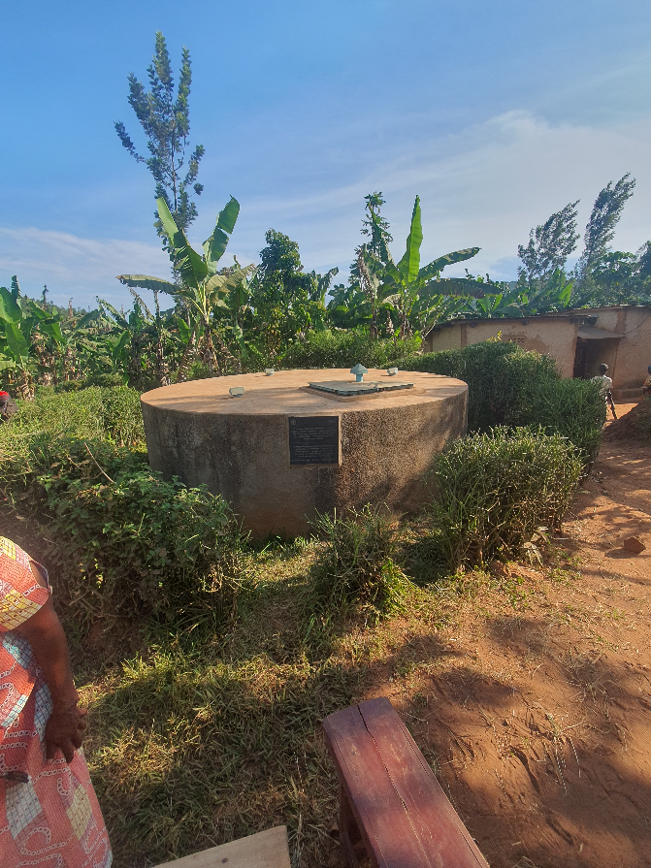
Recommendations: Ministry of Infrastructure (MININFRA)
R-01 — Immediate (0–6 months) — 🟦 Sustainability: Finalise and formally issue the revised DWASHB Standard Operating Procedures, accompanied by a ministerial circular clarifying District WASH Board funding sources under the delegated rural water management model.
R-02 — Within 1 year — 🟦 Sustainability: Create a dedicated district budget line for District WASH Board operationalisation covering sitting allowances, monitoring visits, and reflection meetings, separate from general WASH or district-office budget lines.
R-03 — Within 1 year — 🟦 Sustainability: Design hygiene promotion reinforcement cycles with gender-differentiated approaches, sustaining male-targeted reinforcement sessions beyond the initial behaviour-change period rather than concentrating reinforcement on women alone.
R-04 — Within 1 year — 🟩 Scale-up: Design and pilot a targeted sanitation financing product for the bottom wealth tertile, building on the existing Village Savings and Loan Association architecture to reach households that cite affordability as the primary barrier to upgrading.
Water infrastructure in Rwamagana district, Mwurire sector

Slide 22
Recommendations: RURA and WASAC
Recommendations for RURA (regulator) and WASAC (utility) — the sector's oversight and delivery institutions
For RURA:
For WASAC:
R-05 — Within 1 year — 🟦 Sustainability: Set a binding transition date for the CMS-RWSS platform handover to WASAC, or formalise a co-hosting arrangement with clearly defined responsibilities.
R-06 — Medium-term (2–3 years) — 🟩 Scale-up Opportunity: Introduce periodic independent verification of non-revenue water and district metered area functionality for rural and private-operator systems.
R-07 — Medium-term (2–3 years) — 🟪 Future Programming: Design a distinct tariff and licensing sub-model for small, decentralised private and youth-led rural water operators, recognising their financial viability constraints.
R-08 — Medium-term (2–3 years) — 🟨 Institutional Reform: Develop a regulatory response to the risk of private-connection exit from communal water point governance, addressing the risk that wealthier households withdrawing into private connections erodes the fee base and citizen-oversight layer that communal systems depend on.
R-09 — Within 1 year — 🟩 Scale-up Opportunity: Replicate the district metered area zoning, meter testing, and mWater leak-tracking practices across all remaining WASAC branches, and institutionalise quarterly non-revenue water task-force meetings as standing practice.
R-10 — Medium-term (2–3 years) — 🟪 Future Programming: Treat supply-continuity improvement (storage and transmission capacity) as a capital investment priority distinct from non-revenue water reduction, sequenced by branch using updated district investment plans.

Slide 23
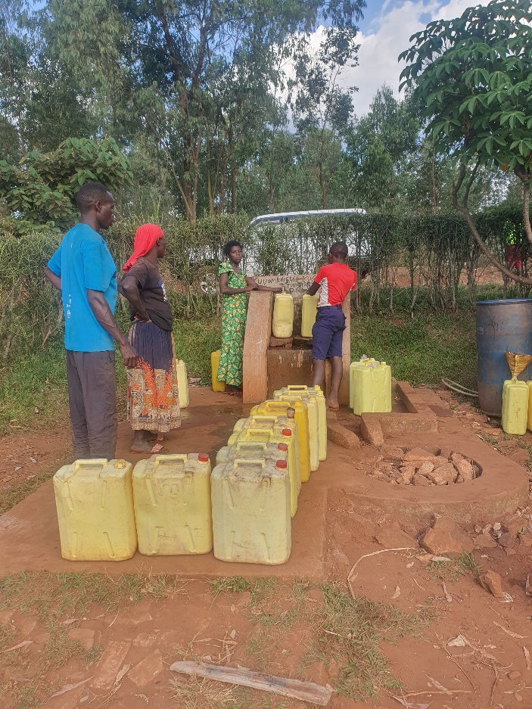
Recommendations: District WASH Boards
Three recommendations for District WASH Boards — the sector's district-level coordination structure
R-11 — Immediate (0–6 months) — 🟦 Sustainability: Formally constitute District WASH Board roles and budget responsibility under the revised SOPs on issuance, and institutionalise semi-annual reflection meetings as a standing, district-chaired item on the governance calendar.
R-12 — Annual cycle — 🟨 Institutional Reform: Use updated, full-life-cycle-costed district WASH investment plans as the actual basis for each district's annual WASH budget submission, rather than as a parallel planning exercise.
R-13 — Within 1 year — 🟦 Sustainability: Continue and formally resource the District Sanitation Centre / community sanitation showroom supply chain, preserving the price-tiered relationship between national distributors, DSCs, community sanitation showrooms, and village agents through a coordination agreement with Private Sector Federation district managers.
Water collection point in Kirehe, Rwantonde

Slide 24
Recommendations: District Government
Four recommendations for direct district-level action
R-14 — Within 1 year — 🟦 Sustainability: Formally close the gap between district WASH investment plans and the district budget cycle by integrating WASH investment plan priorities into annual district budget submissions as standard practice.
R-15 — Within 1 year — 🟨 Institutional Reform: Close the accountability gap between DWASHB oversight and private-operator performance by requiring monthly technical and financial reports to WASH committees in a standardised format.
R-16 — Within 1 year — 🟩 Scale-up Opportunity: Use the Rwamagana peer-learning model as a standing peer-exchange mechanism, targeting the districts where NRW remains above 38% and youth-led operators are still consolidating.
R-17 — Ongoing — 🟦 Sustainability: Absorb Hygiene Focal Points into the district's existing community health structures, ensuring they are supervised, tasked and reimbursed through the same systems as Village Health Workers and CBEHPP agents.

Slide 25
Recommendations: Implementing Consortium, and US Government
Three recommendations for the consortium — structured handover, market model preservation, and future programme design
Two recommendations for US Government (U.S. Department of State).
For Implementing Consortium:
For US Government:
R-18 — Immediate — 🟦 Sustainability: Produce a structured handover note, district by district, on the state of operator capacity, NRW monitoring infrastructure and sanitation market systems at project close — flagging which operators are most fragile and which DSC/CSS nodes have the weakest continuation prospects.
R-19 — Future — 🟪 Future Programming: Use the Decision Intelligence (DQ) selling methodology and Village Agent network as the starting point for sanitation programming in new districts.
R-20 — Immediate — 🟦 Sustainability: Formally transfer coordination of the DSC / community showroom supply chain to PSF district managers through a written coordination agreement.
R-21 — 🟪 Future Programming: Future awards should specify institutionalisation milestones (adoption into government training and recruitment, tools transferred to and hosted by a named government entity, SOPs formally approved) as reportable deliverables with intermediate deadlines, rather than as close-out activities
R-22 - 🟪 Future Programming: Future investments in market development or systems strengthening should be undertaken integrated with capital finance component.

Slide 26
Thank you

